Slide 1

Exploring NSE Sectors through Stock Market Analysis

Slide 2
Table of contents
Introduction
Fundamental & Technical Analysis
Sector wise Analysis
Returns on Trading Volume
Correlation
Trend Analysis
Volatility Analysis
Stock Prices over time
Scatter Plot
PE Ratio
Last 5 year return
Conclusion

Slide 3
Introduction:
The stock market is a financial system that enables companies to raise capital by offering stock shares and corporate bonds. Investors can participate in businesses, share capital gains, and earn income through dividends.
In India, there are two national stock exchanges: the National Stock Exchange (NSE) and the Bombay Stock Exchange (BSE), along with 21 regional stock exchanges (RSE).
The project focuses on NSE, which pioneered electronic or screen-based trading, starting its operations in 1994.

Slide 4

Fundamental & Technical Analysis:
In the stock market, various factors influence the price and movements of a stock. However, this project prioritizes fundamental details such as Return On Equity ratio (ROE), Profit to Equity (PE), dividend history, and annual earning history for predicting price movements.
Unlike fundamental analysis, technical analysis relies solely on studying data and charts from past market history, independent of external factors. Both analyses aid in examining multiple stocks and their price movements across significant time periods.

Slide 5
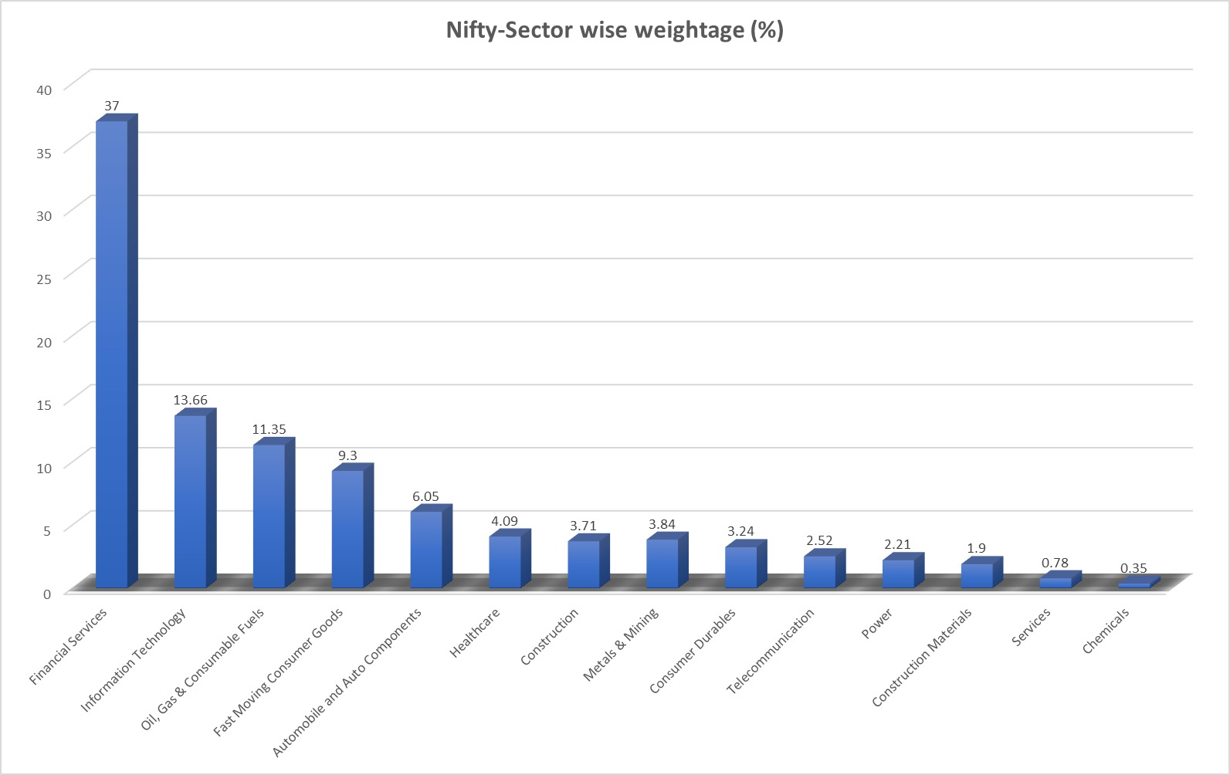
Sector wise Analysis:
Out of 2,113 companies the financial services sector holds the largest weightage in Nifty-50, accounting for 37%, and includes a total of 118 companies.
Following closely is the IT sector with a weightage of 13%, comprising 83 listed companies on the NSE.

Slide 6
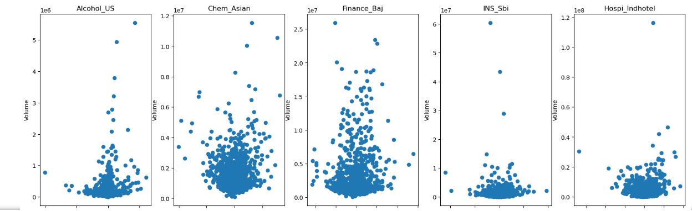
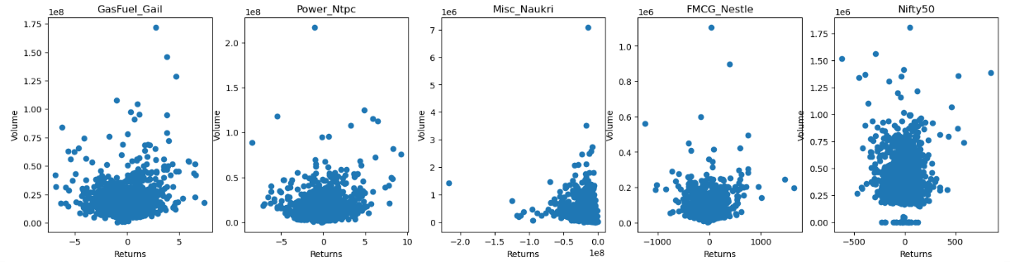
Returns on Trading Volume:

Slide 7
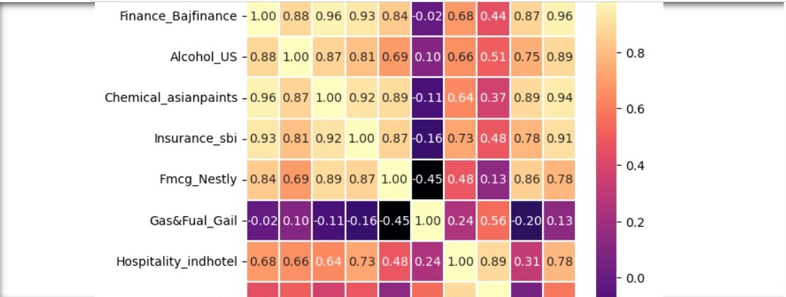
Correlation:
As seen in the correlation heatmap above, Alcohol (United Spirit), Chemical (Asian Paints), Insurance (SBI Life Insurance), FMCG (Nestle), Hospitality (Indian hotel) and Miscellaneous are perfectly co-related with Bajaj Finance and Nifty 50.
Where as, Gas & Fuel (GAIL) and Power(NTPC) are negatively co-related with Bajaj Finance and Nifty 50.

Slide 8
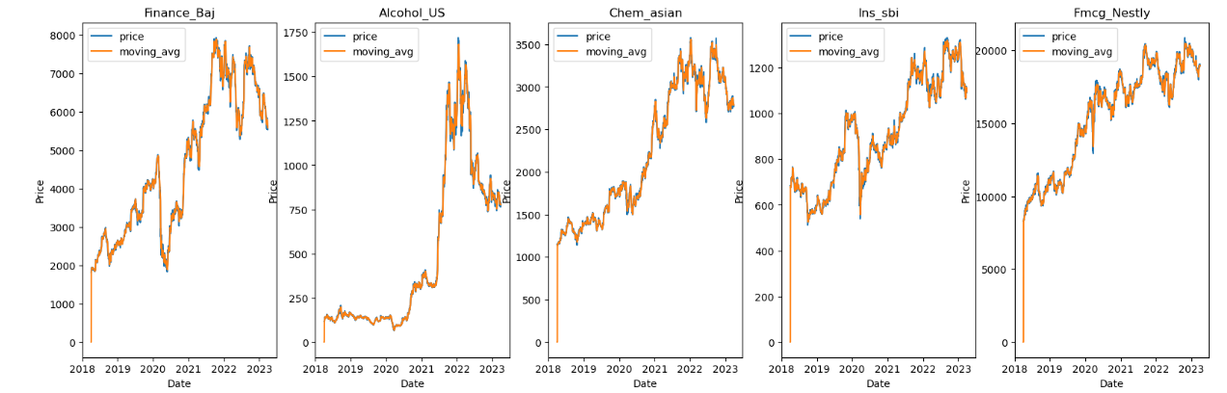
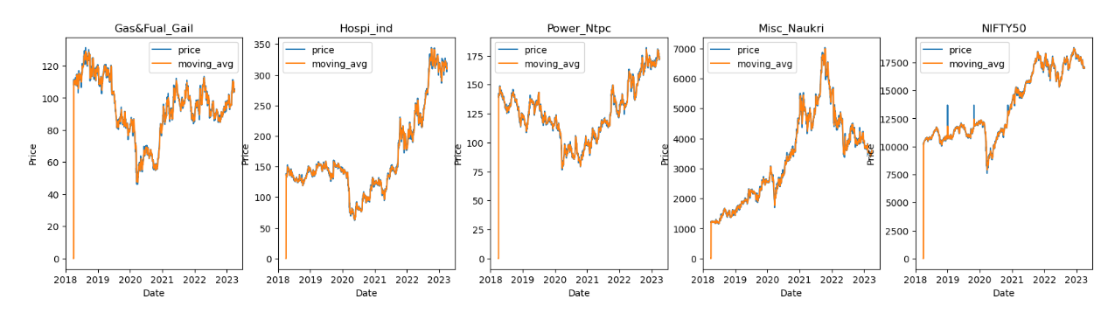
Trend Analysis:
Nestle India and SBI both are frequently trading below moving average.
NTPC is trading above moving average

Slide 9
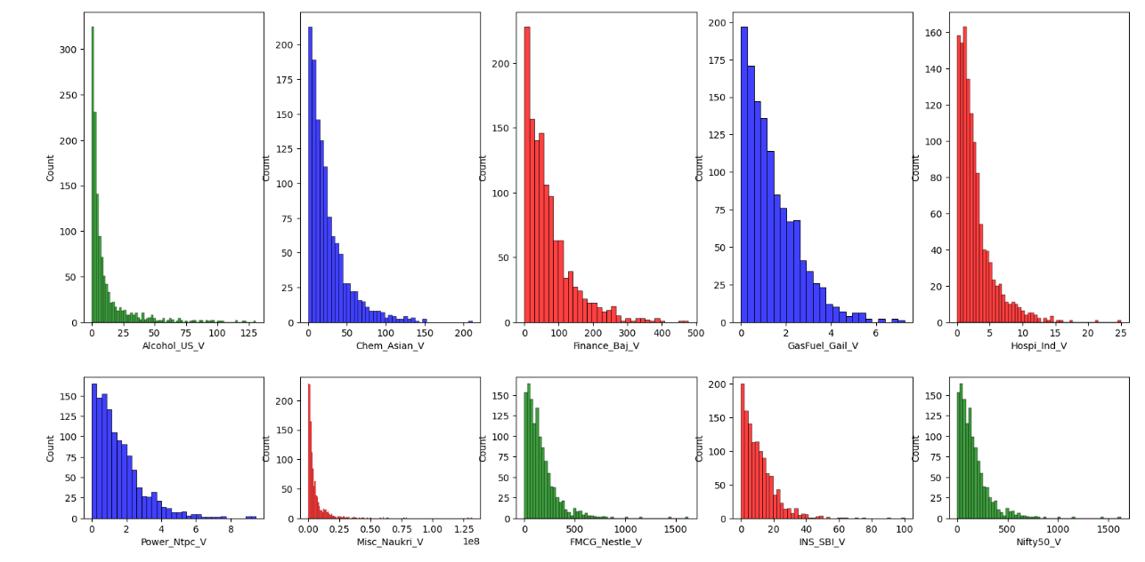
Volatility Analysis:
As seen in the GAIL and NTPC both are volatile stocks where one can invest for short term.

Slide 10
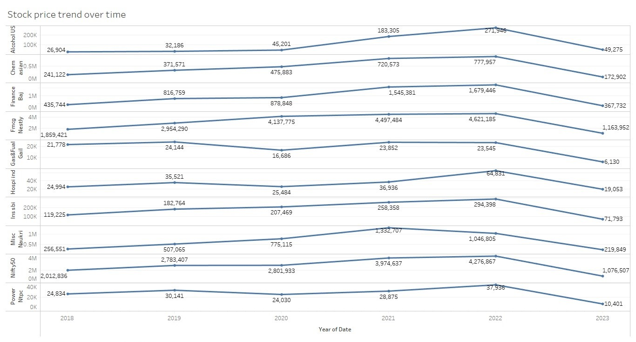
Stock Prices over time:
From the year 2021 to 2022 Nestle & GAIL are perfectly positively co-related with Nifty 50, as they are maintaining their all time high.
Comparatively, as seen in the chart other stocks are not able to sustain at higher profits due to profit booking.

Slide 11
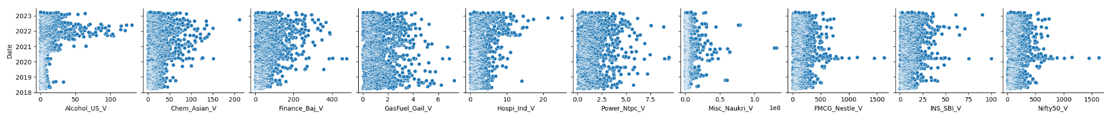
As seen in the scatter plot, Bajaj Finance, SBI Life Insurance, GAIL and NTPC during the (major event) 2019 pandemic outbreak could maintained their average price. Where as comparatively, other companies stock prices seen a steep downfall.
Scatter Plot:

Slide 12
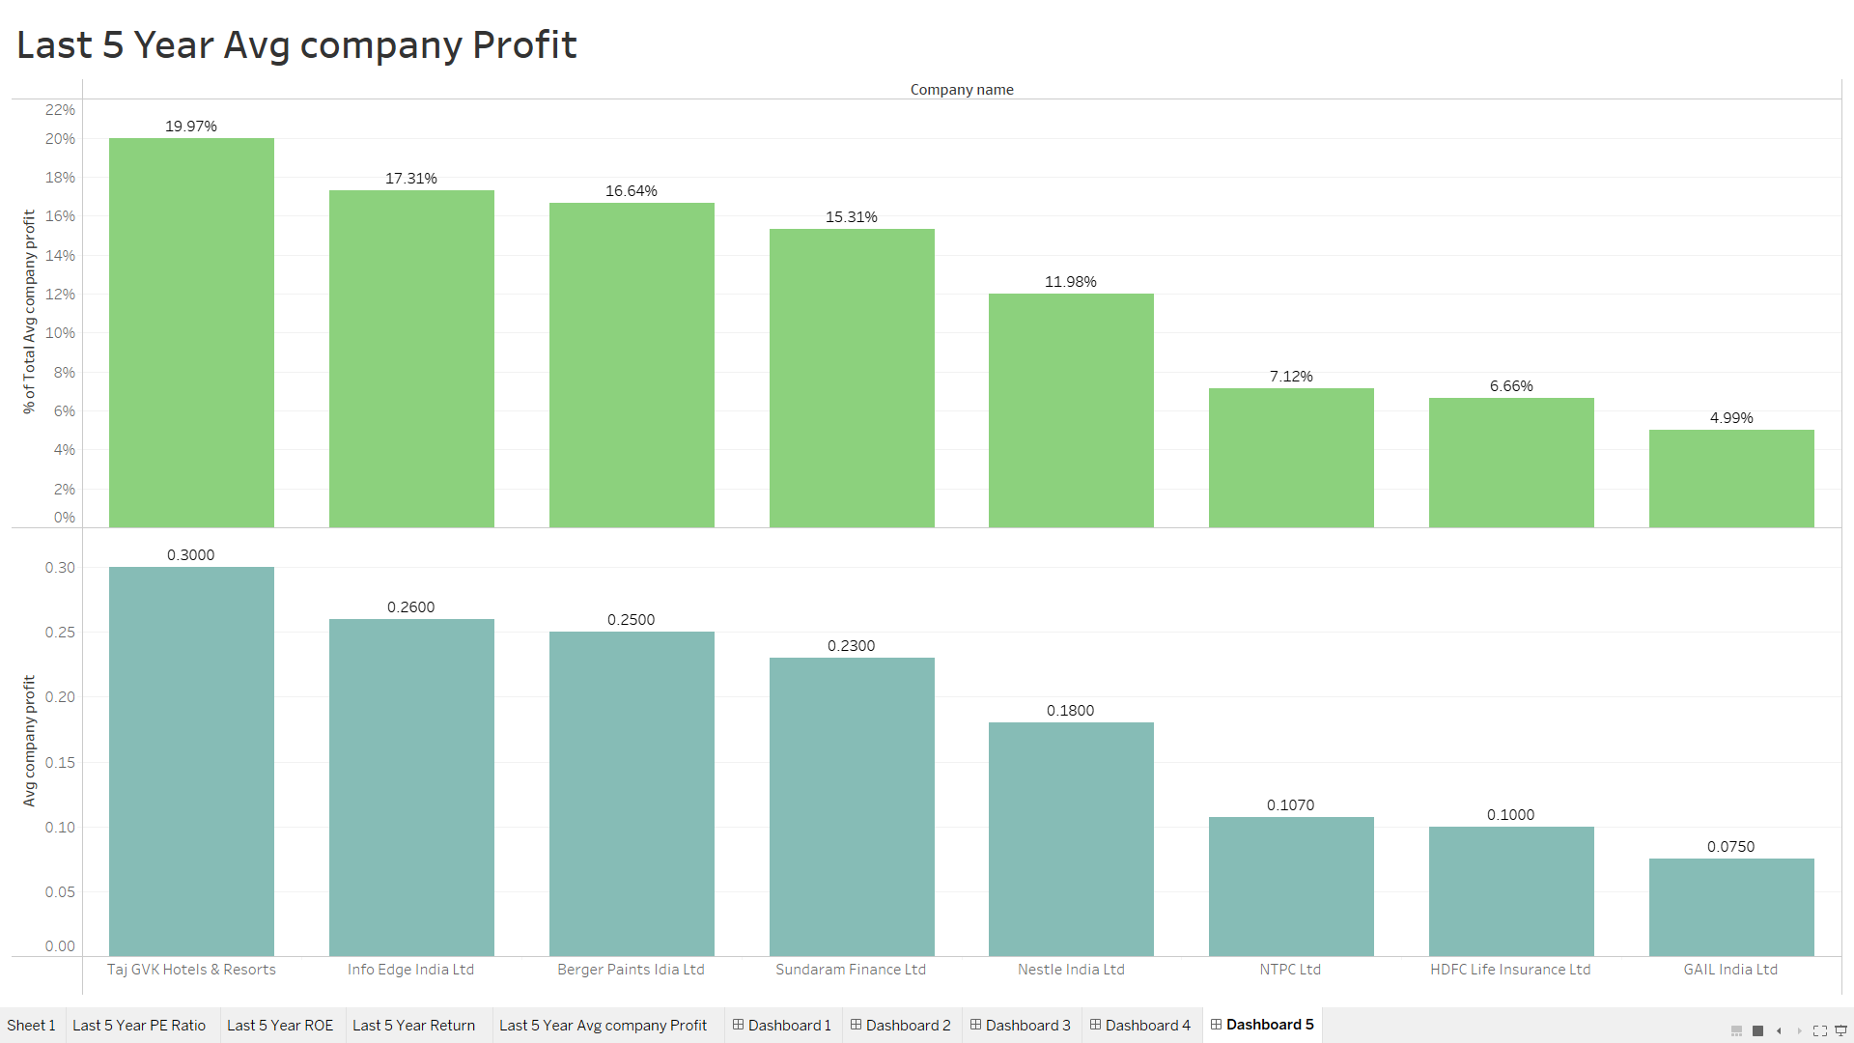
As seen in the above slide, Service sector like (Hotel Industry) faced downfall, but recovered and maintained their average profit. One can consider investing in service sector to balance portfolio.

Slide 13
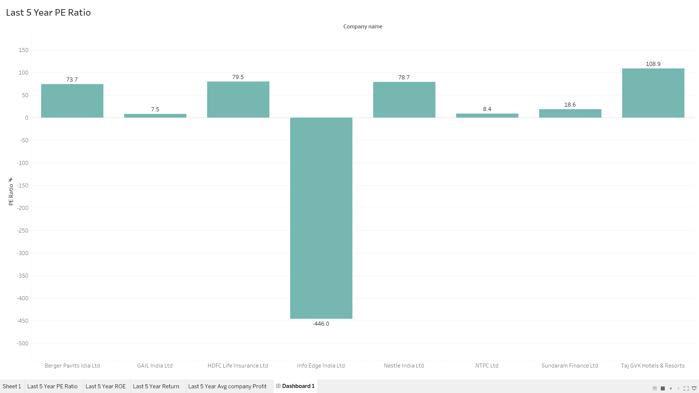
PE Ratio for last 5 years:
Observations:
As seen in the bar chart Info edge India ltd. is highly undervalued with a average PE ratio of -446.0 for the last five years.
Comparatively, TAJ GVK hotels & resorts is highly overvalued with a PE ratio of 108.9 for the last five years.

Slide 14
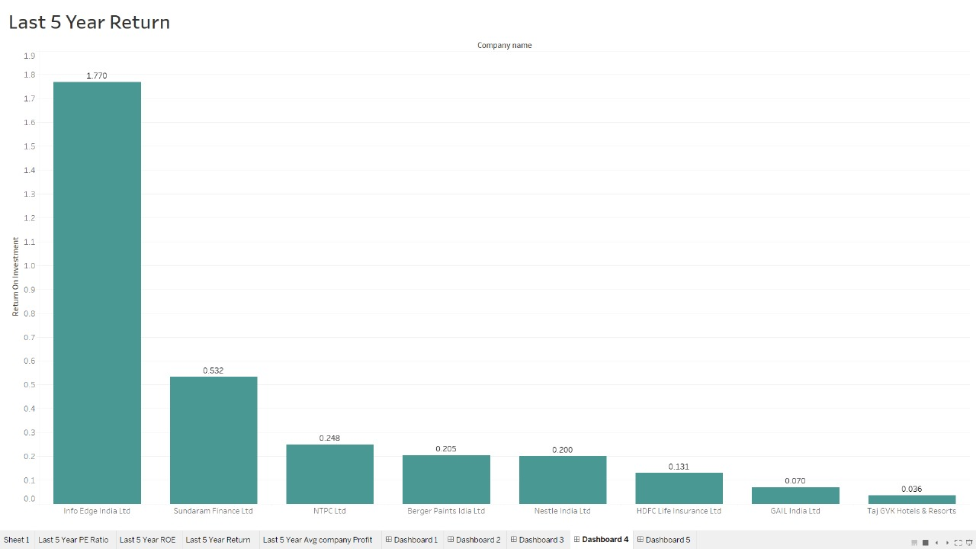
Last 5 year return:
Observations:
In the last five years even when Info edge is undervalued it has given higher profits consistently and still has potential to give good returns.

Slide 15

Recommendations:
Lower Risk Plan:
Info edge, Sundaram finance, Nestle India, Gail and HDFC life
Medium Risk Plan:
Sundaram Finance, GAIL, Info edge, Berger paint, HDFC life
Higher Risk Plan:
Info edge, Sundaram Finance, GAIL, NTPC, Berger paint and TAJ GVK hotel and resort.

Slide 16
Conclusion:
In this project, we conducted an analysis of Nifty 50, examining nine sectors encompassing both large-cap and mid-cap companies. Utilizing various analytical tools such as Python, Excel, and Tableau, we delved into the market dynamics. Our analysis revealed that the Finance, Gas & Ind, and FMCG sectors exert a significant influence on the upward and downward movements of Nifty 50. Subsequently, we formulated recommendations based on these insights.
Tailoring our approach to accommodate diverse investor budgets, we devised three distinct plans: a lower-risk plan, a medium-risk plan, and a higher-risk plan, each aligned with an individual's risk appetite. These plans aim to provide investors with strategic options that align with their financial goals and risk tolerance.

